Slide 1
PnP Community Call – March 2015
aka.ms/OfficeDevPnP
aka.ms/OfficeDevPnPYammer
aka.ms/OfficeDevPnPGuidance
aka.ms/OfficeDevPnPVideos
PnP Core Team

Slide 2

Agenda
Demos, demos, demos
Monthly highlights
Contributions and other topics
Roadmap and next steps

Slide 3
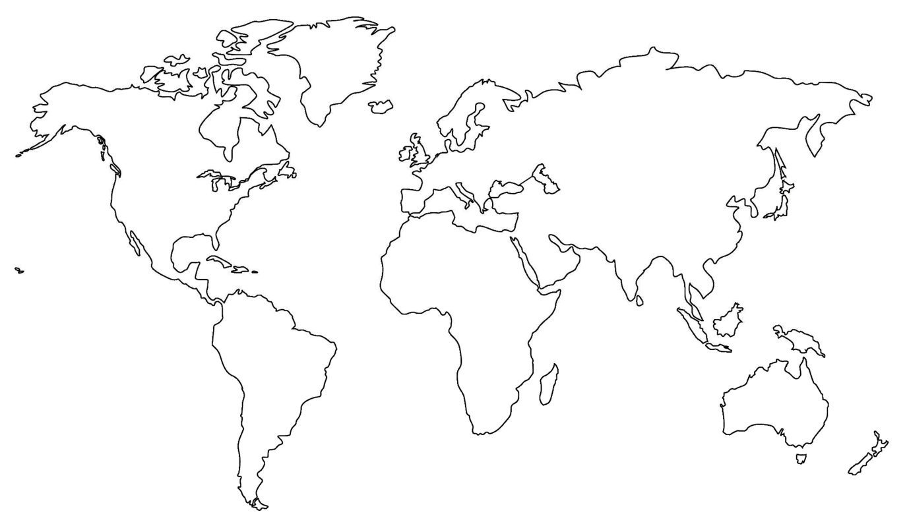

Where are you located?
Stamp Tool
Notes:
Length: 2 minutes for this slide
This slide is a quick demo/practice of the “Stamp” tool and how to use it during course interactions.
Have students Check where they live.
If it’s a small class, have students type their name where they live.
Reach out to the farthest away student

Slide 4


Developer
Patterns & Practices
aka.ms/OfficeDevPnP
aka.ms/OfficeDevPnPYammer

Slide 5
PnP model
Reusable samples and solutions
Core component
Community
Training
Presentations
PnP
JDP program
Guidance / MSDN
Seminar materials
Videos
Other assets

Slide 6
Statistics– Key numbers (previous month)
Forked 360 times (282, 227, 190, 135)
384 merged pull requests (329, 280, 236, 189)
101 closed issues (73, 67, 58, 43)
More than 4200 (3776, 2566, 3050, 2160) unique visitors during last 2 weeks
Nuget package 4711 downloads (4450, 4030, 3800)
Yammer group has 2013 members (1739, 1525, 1419, 757)
aka.ms/OfficeDevPnPYammer
Facebook page has 135 likes (135, 121)
https://www.facebook.com/OfficeDevPnP

Slide 7
March Release
Core component v1.0 released
Remote timer job framework 1.0 released
New samples and solutions
Significant amount of new Channel 9 videos
New MSDN linked articles
Note. Site provisioning framework is delayed, but still planned to get released during March

Slide 8

Thank you for your assistance!
Erwin van Hunen (Knowit AB) - @erwinvanhunen
Guillermo Bas (ClearPeople) - @guillebas
Matthieu Anceret - @AnceretMatthieu
Mikael Svenson - @mikaelsvenson
Nanddeep Nachan - @NanddeepNachan
Paolo Pialorsi (PiaSys.com) - @PaoloPia
Patrik Björklund (Alloc IT) - @pbjorklund
Paul Schaeflein - @paulschaeflein
Radi Atanassov (OneBit Software) - @RadiAtanassov
MS people – Antons Mislevics, Frank Marasco, Bert Jansen, Jeremy Thake, Vesa Juvonen, Brian Michely, Reeza Ali, Suman Chakrabarti, Ricky Kirkham, Steve Walker, Dan Budimir, Frank Chen, Kiki Shuxteau, Laura Graham, Ron Tielke, Sami Nieminen

Slide 9
New contributions
New sample Provisioning.Cloud.Async.WebJob demonstrates how to build an asynchronous self-service site collection provisioning solution using Azure Storage Queues and Azure WebJobs.
New sample Core.QueueWebJobUsage shows how to perform operations on-demand with Azure WebJobs as continuously running operation, which will handle incoming requests from message queue.
New samples Core.AppEvents and Core.AppEvents.HandlerDelegation shows how to implement handlers for the AppInstalled and AppUninstalling events that
New sample Core.SiteInformation shows information about the current site collection with a "Site Information" custom action menu item.
New sample Provisioning.Cloud.Workflow shows how to use a workflow to provision a SharePoint site by using the remote provisioning pattern and CSOM triggered from the host web. This sample was ported from the MSDN code gallery.
New sample Provisioning.Cloud.Workflow.AppWeb shows how to use a workflow to provision a SharePoint site by using the remote provisioning pattern and CSOM triggered from the app web. This sample was ported from the MSDN code gallery.
New sample Provisioning.Batch demonstrates how to create a console app that provisions a batch of site collections by using the CSOM and the app model. This sample was ported from the MSDN code gallery

Slide 10
PnP Core Timer Job Framework
New solution Core.TimerJobs.Samples shows how you can use the PnP Core timer job framework to create your own timer jobs. 10 different timer job samples will explain you the ins and outs of the PnP Core timer job framework

Slide 11
Updated contributions
Updated sample Core.LargeFileUpload now shows how to large file upload by uploading the file in parts. There's also a table giving an overview of the various upload methods and guidance on when to use which one
Updated sample Office365Api.Overview has been extended with a ASP.Net forms sample
Updated component Core.TaxonomyPicker now can better handle large termsets + only loads the language resource file once if there are multiple instances on the same page. Overall a nice performance improvement.
Updated solution PowerShell.Commands with additional commands and various other updates. See the changelog of the PowerShell solution for more details. Next to that the individual commands now have documentation in the MD format.

Slide 12
Key Updates to PnP Core and miscellaneous
Timer job engine is part of the PnP Core. Extensive documentation can be found here
Updated logging implementation based on Trace class
Search extensions that support configuring the search center and importing/exporting search settings
Support for setting variations settings and for creating variation labels
Support for setting JSLink on a list
Support for removing taxonomy fields and their associated hidden fields
Navigation extensions now supports search navigation
Language neutral handling of error messages
Send email can now also use the CSOM SendEmail method
CreateTaxonomyField now correctly set the ShowField property
CheckIn and CheckOut methods are more resilient

Slide 13
Updates in the Guidance repository
Significant set of new MSDN linked articles
Guidance – http://aka.ms/OfficeDevPnPGuidance
MSDN– http://aka.ms/OfficeDevPnPMSDN

Slide 14
PnP Channel 9 – New Videos
http://aka.ms/OfficeDevPnPVideos
Self service site collection provisioning to Office 365 with Azure WebJob
Asynchronous on-demand operations in Office 365 with Azure storage queues and WebJobs
Hybrid site collection provisioning from Azure to on-premises
User profile CSOM for reading and updates
Integrate Yammer feeds to SharePoint sites
Information management policy with app model
Document and list templates with app model
Creating content types and site columns with CSOM
Introduction to Managed Metadata CSOM

Slide 15
PnP training
http://aka.ms/OfficeDevPnPTraining
Training based on the PnP material available for anyone to use
Presentations, demos and hands on labs
Introduction to app model
Managing site settings using app model
Branding with app model
Building UX components with app model
Using remote event receivers and remote timer jobs
Site collection and site provisioning
User personalization and OneDrive 4B
ECM capabilities with app model
Using search with app model
Transforming customizations to app model
Download as use as you wish…

Slide 16


Core team extended
Paolo Pialorsi (PiaSys.com)
Radi Atanassov (OneBit Software)

Slide 17

Roadmap – April release plan
Provisioning engine v1.0
Core component v1.x
Continue evolving the Core component
Samples and solutions
More advance topics in queue for complex Azure scenarios for example for LOB integration
Articles
MSDN updates
On-premises App model setup – options and details on the needed configuration
Enterprise architect messaging
ALM
Recipes for transformation
JDP process to be released as reusable package for the field

Slide 18
Feedback…
Please keep the feedback coming in Yammer… we need your input for the prioritization.
Notes:
Priority on planned topics
More code samples
Add core component capabilities
Reusable presentation material
Documentation on patterns and practices for app model (ALM ec.)
More complex solutions
More Office Client apps
More JavaScript app
Length: 30 second for this slide
Instructor notes
The following slides will walk you though the Lync tools that we will use in this class.
You will use all of these tools later in the class
Stress that your students will be able to run much more engaging meetings if they use these tools in their own Lync Meetings.
Course Development Notes:

Slide 19

Demos, demos, demos!
Frank – Site provisioning XML
What will be released for site provisioning
Bert – Timer Job framework
What was released and how it works
(optional if time permits)
Vesa – Async operations with storage queues and WebJobs

Slide 20
Transform your code Providing App Model Patterns for common Full Trust Code scenarios
130+ Visual Studio projects Common scenarios
Branding
Site provisioning
Remote event receivers
Large file support
Taxonomy driven navigation
And much more…
Contribute
This is open source project and open for contirbutions
Developer
Patterns & Practices
aka.ms/OfficeDevPnP

Slide 21

Questions?

Slide 22


© 2014 Microsoft Corporation. All rights reserved. Microsoft, Windows, and other product names are or may be registered trademarks and/or trademarks in the U.S. and/or other countries.
The information herein is for informational purposes only and represents the current view of Microsoft Corporation as of the date of this presentation. Because Microsoft must respond to changing market conditions, it should not be interpreted to be a commitment on the part of Microsoft, and Microsoft cannot guarantee the accuracy of any information provided after the date of this presentation. MICROSOFT MAKES NO WARRANTIES, EXPRESS, IMPLIED OR STATUTORY, AS TO THE INFORMATION IN THIS PRESENTATION.

